Slide 1
Figure 3 (Kohsaka)
Reference: https://journals.aps.org/prb/abstract/10.1103/PhysRevB.95.115307

Slide 2
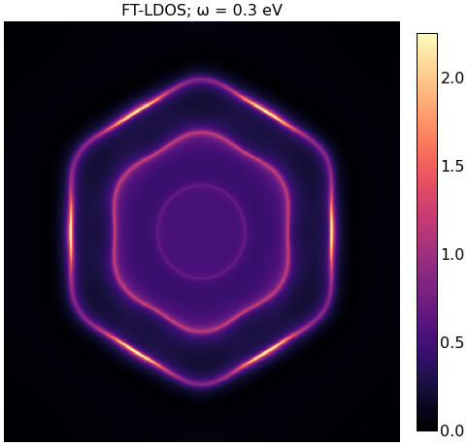
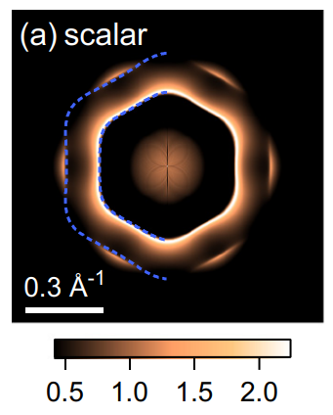
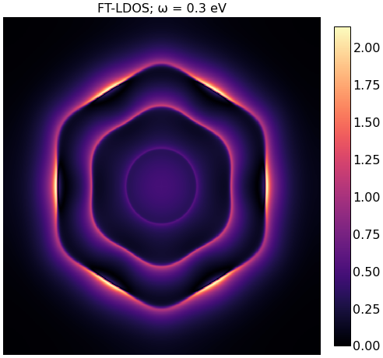
Left: Reproductions of Fig. 3(a) (800x800). Top is with T-matrix formalism, and bottom is setting T = V.
Right: Original Fig. 3(a)

Slide 3
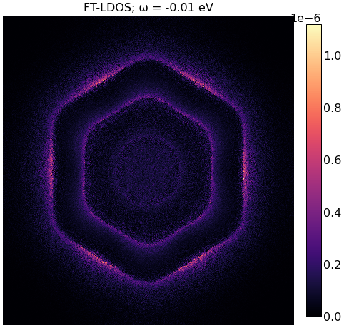
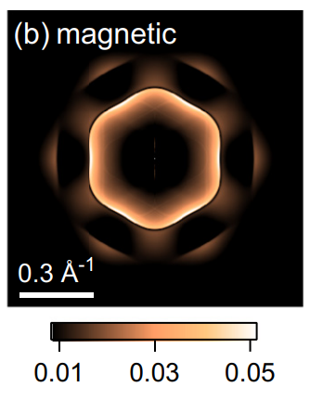
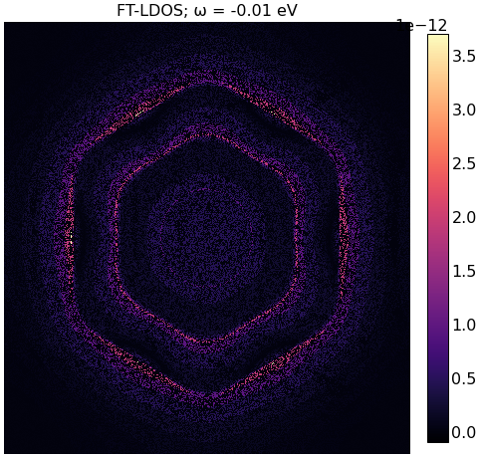
Left: Reproductions of Fig. 3(b) (800x800). Top is with T-matrix formalism, and bottom is setting T = V.
Right: Original Fig. 3(a)

Slide 4
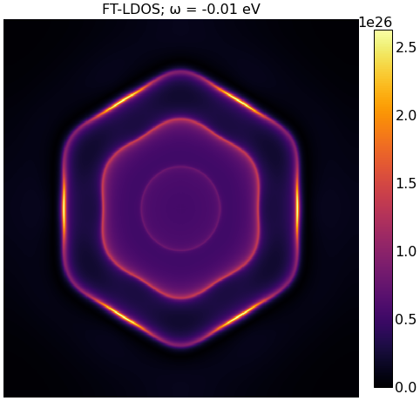
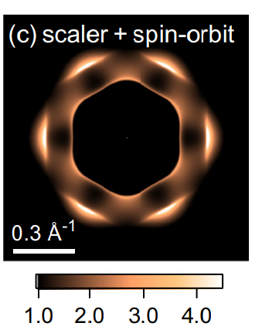
Fig 3(c) Reproduction vs. original.

